Slide 1

Group 1 - Zetian Zhao, Mingyue Zhao, Skylar Shao
Milk Quality Classification
572 Group Project
2025-02-05
1

Slide 2
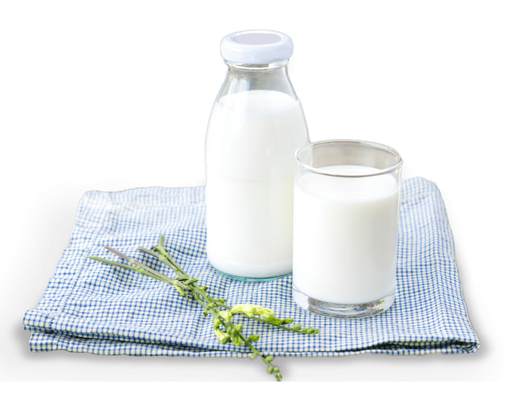
Introduction
Objective: Classify milk quality (Low, Medium, High) using supervised learning.
Methods: Compare three models, apply feature scaling, tuning, and validation.
Goal: Identify the best-performing model and analyze how preprocessing impacts accuracy.
2

Slide 3
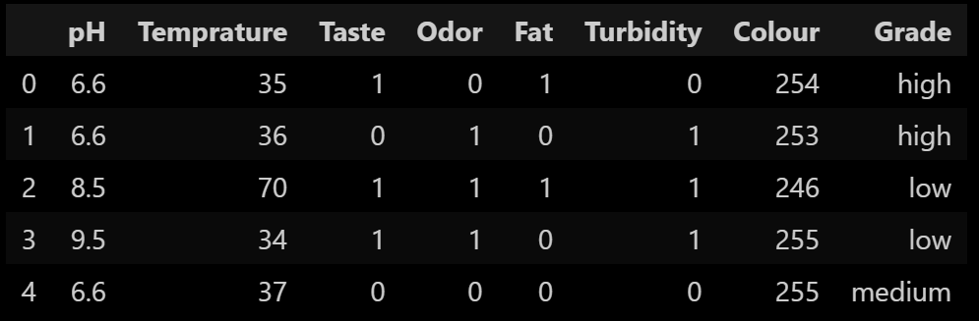
Data
Overview:
Description:
Source: : Kaggle – Milk Quality Datase
Number: 1059
8 columns (['pH', 'Temprature', 'Taste', 'Odor', 'Fat ', 'Turbidity', 'Colour', 'Grade'])
Missing data: 0
Duplicates: 976 (We didn’t delete them, because we think they’re necessary for modeling)
3

Slide 4
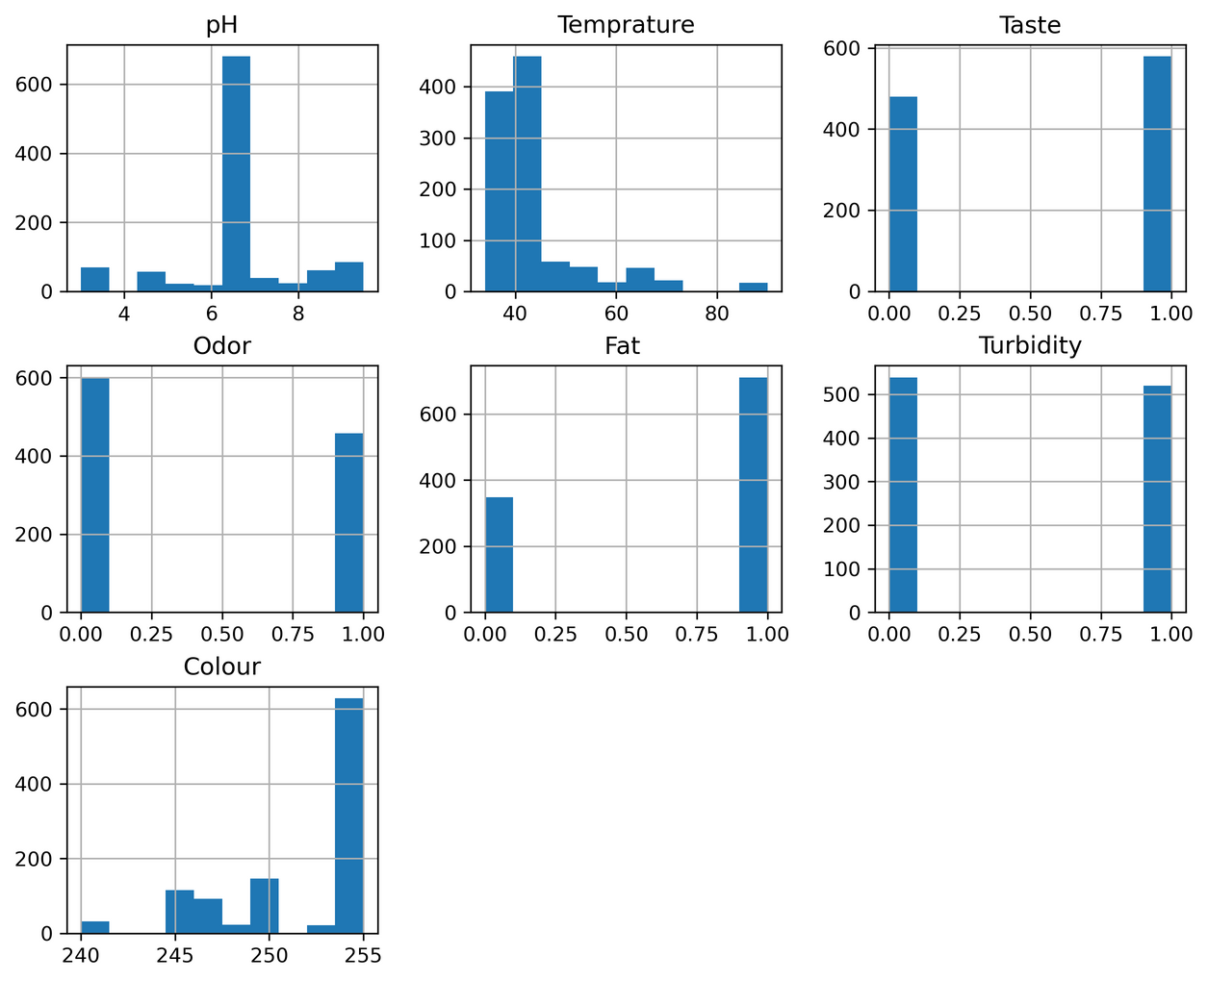
Dataset Overview
Quantitative features (continuous):
pH – Acidity level of the milk.
Temperature – Measured in degrees Celsius.
Colour – Numeric representation of milk color
Qualitative (binary value):
Taste – Good or bad.
Odor – Acceptable or not.
Fat – Sufficient or insufficient.
Turbidity – Cloudiness level for milk.
Target Variable:
Quality: Low, Medium, High.
4

Slide 5
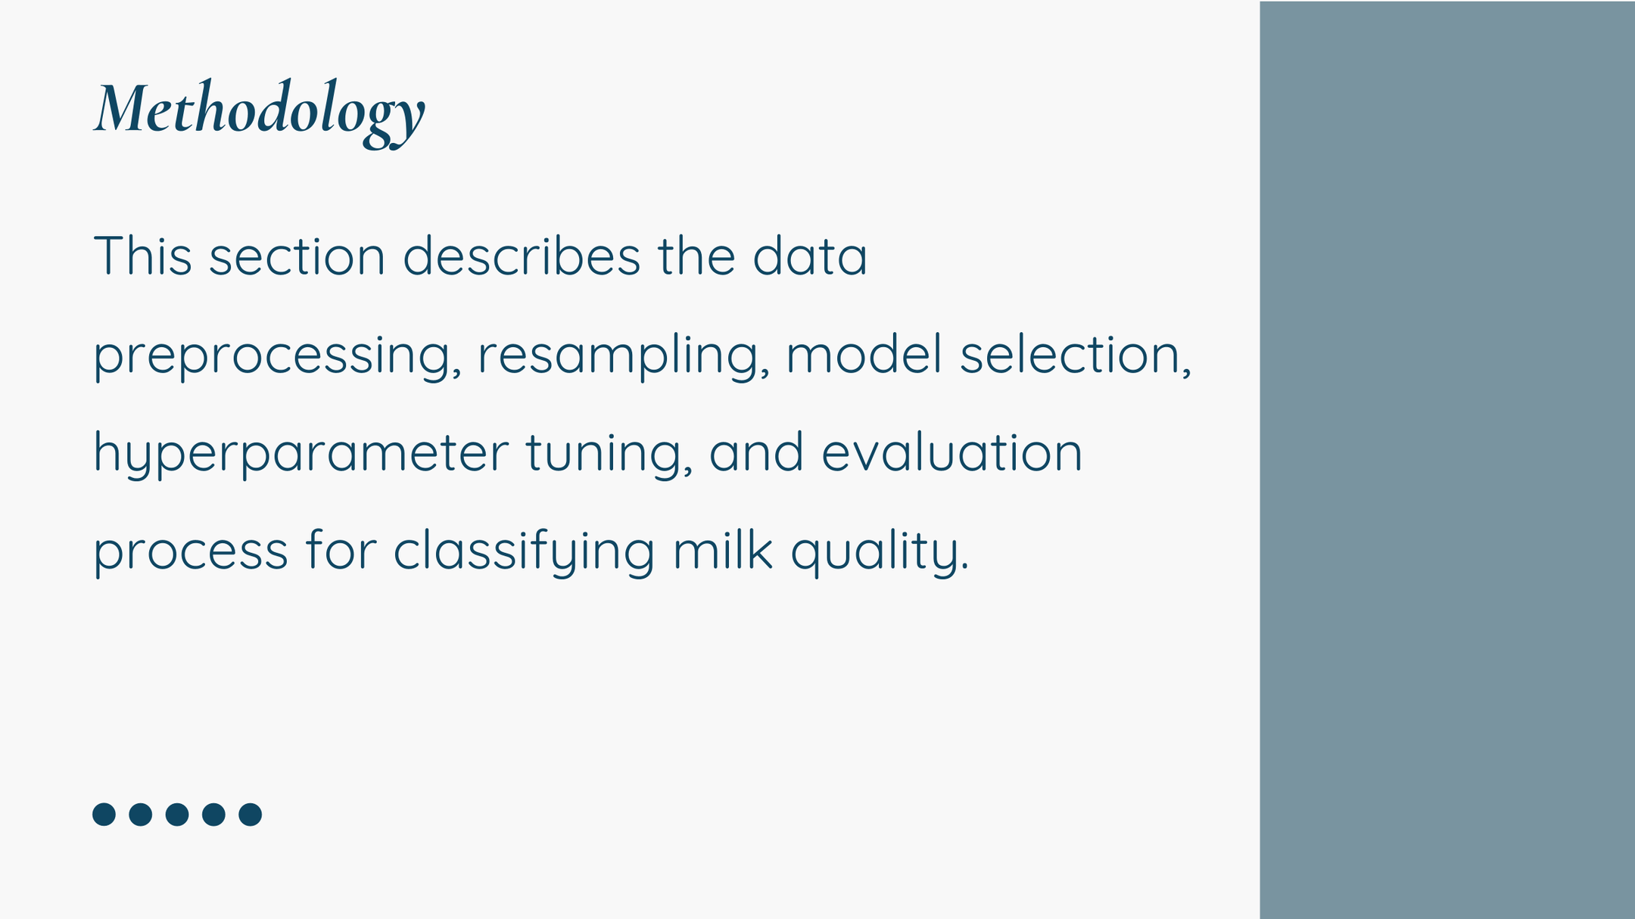
5

Slide 6
Procedure
Data Normalization:
Compare the performance of normalized and unnormalized data.
Model Choices:
Logistic Regression
Random Forest
Decision Tree
Model Comparision:
Compare the performance of those three models before tuning.
Model Tuning:
Find the best parameters for each model.
Model Comparision:
Compare the model performance before & after tuning and mormalization.
6

Slide 7
Why these model?
Logistic Regression
Decision Trees
Random Forests
A simple but effective linear model used for classification. It estimates the probability of a sample belonging to a specific class using a sigmoid function.
A rule-based models that split the dataset using feature thresholds. They learn hierarchical decision rules to classify data effectively.
An an ensemble method that builds multiple decision trees and aggregates their predictions for improved accuracy.
Simple & efficient for classification.
Works well with numerical & categorical data.
Provides interpretable feature importance.
Handles non-linear relationships effectively.
No need for feature scaling or preprocessing.
Easy to visualize and interpret.
Reduces overfitting by combining multiple trees.
Handles missing values & noisy data well.
Provides high accuracy & robustness.
7

Slide 8
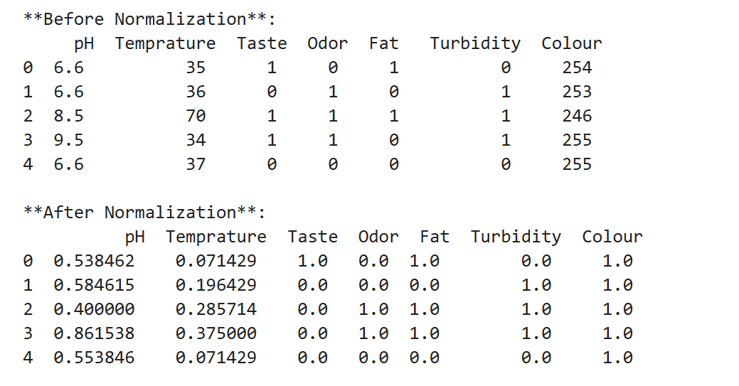
2 Data Preprocessing
Normalization:
MinMaxScaler applied to numerical features
Categorical feature (Grade) remained unchanged
Output =>
8

Slide 9
Before Normalization
9

Slide 10
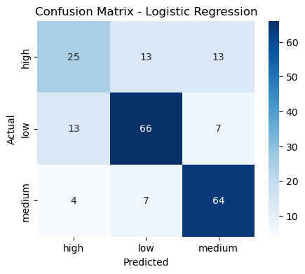
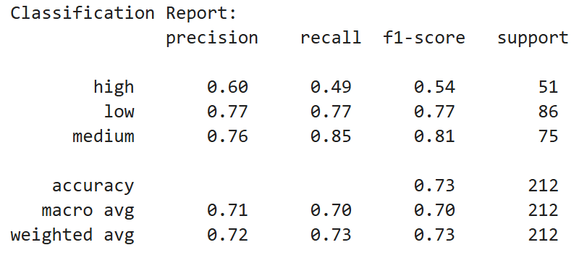
Data Accuracy Before Tuning
Logistic Regression: Test Accuracy: 0.7311
10

Slide 11
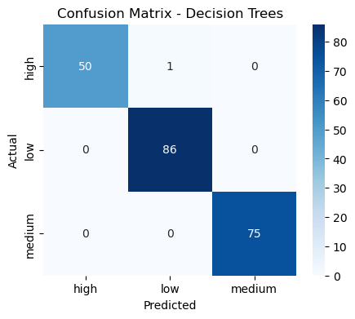
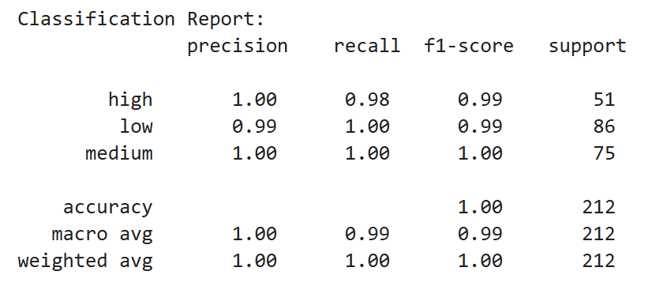
Data Accuracy Before Tuning
Decision Trees:
Test Accuracy: 0.9953
11

Slide 12

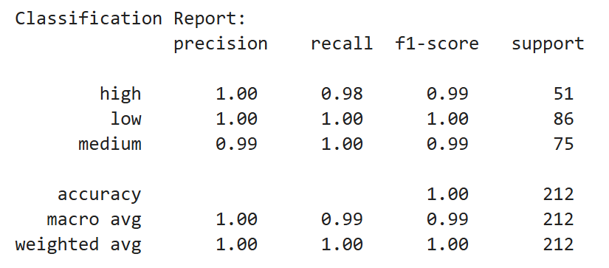
Data Accuracy Before Tuning
Random Forests:
Test Accuracy: 0.9953
12

Slide 13
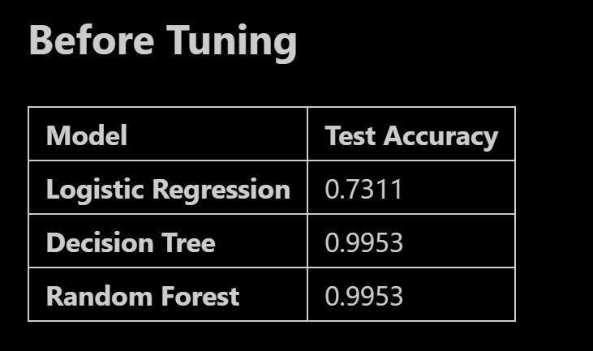
Data Accuracy Before Tuning
13

Slide 14
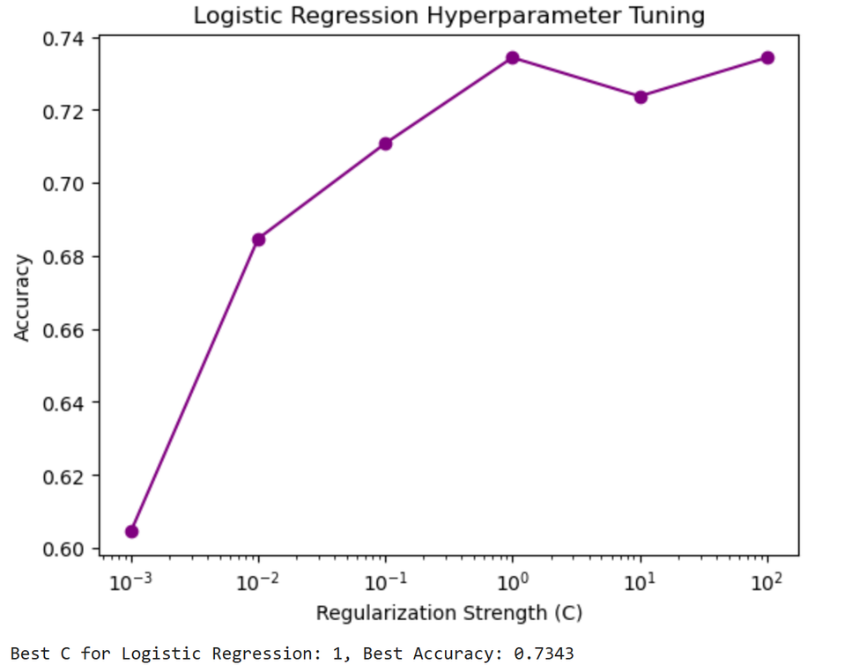
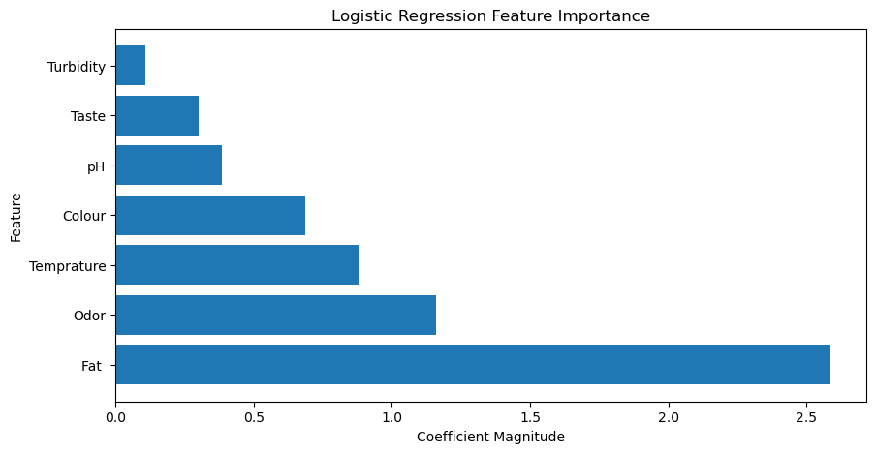
Data Accuracy After Tuning
Logistic Regression:
Test Accuracy: 0.7380
Best C for Logistic Regression: 1
14

Slide 15
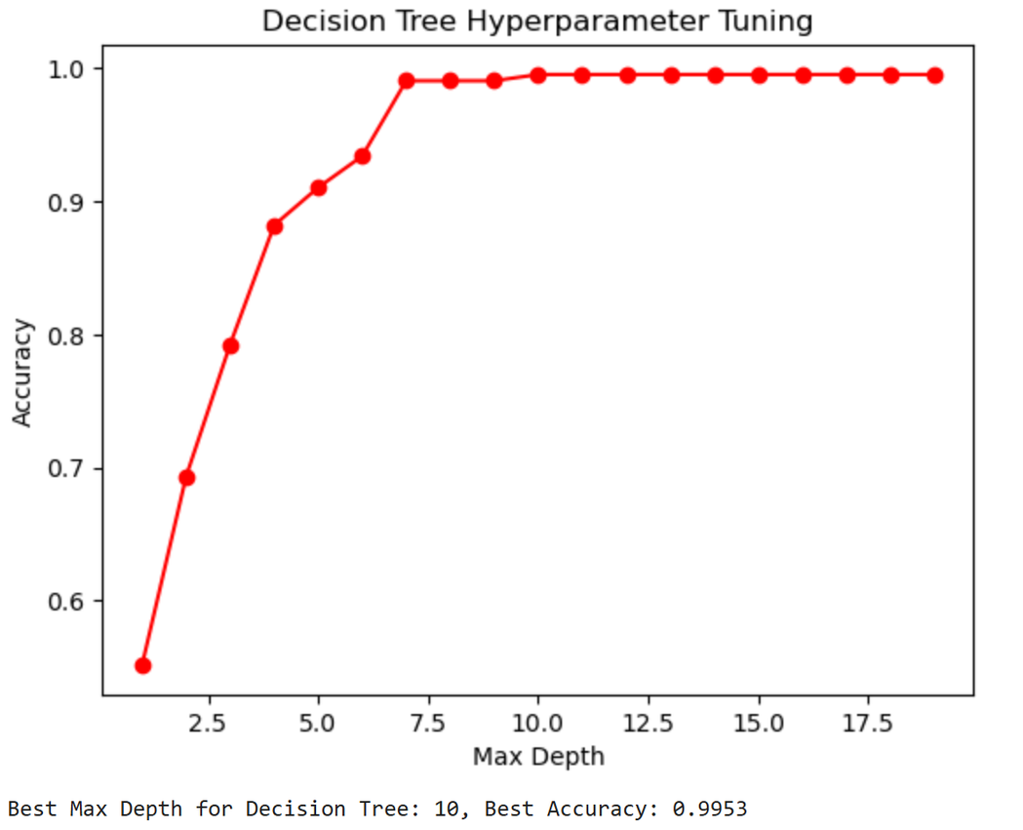
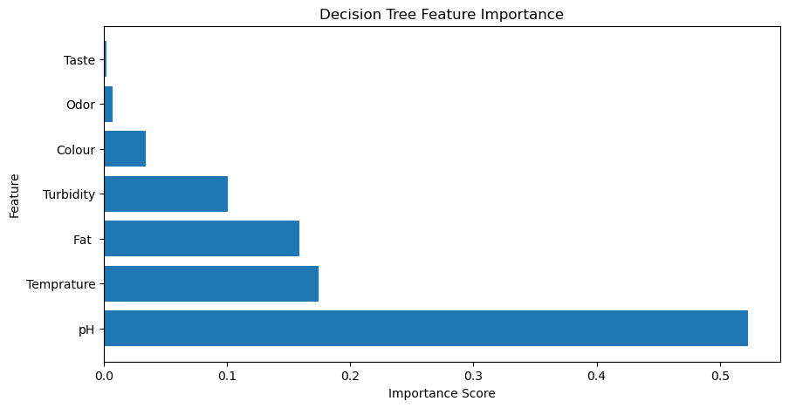
Data Accuracy After Tuning
Decision Trees:
Test Accuracy: 0.9965
Best Max Depth for Decision Tree: 10
15

Slide 16
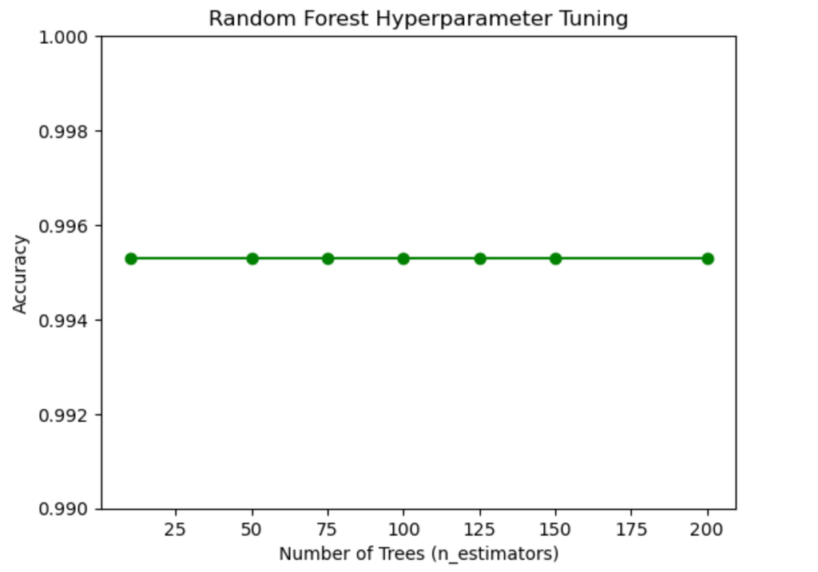
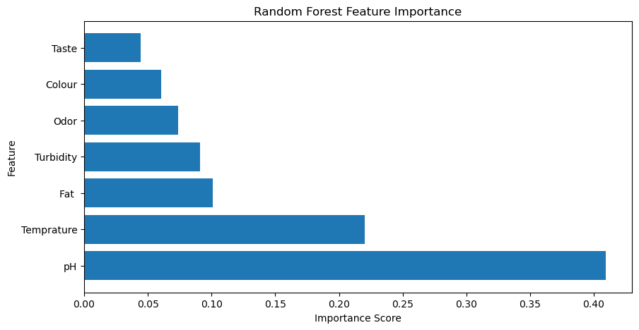
Data Accuracy After Tuning
Random Forests:
Test Accuracy: 0.9988
Best n_estimators for Random Forest: 10
16

Slide 17
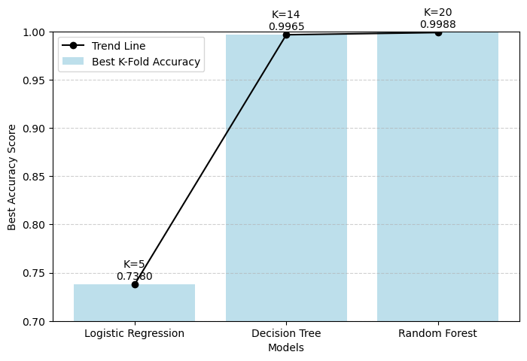
Data Accuracy After Tuning (k-fold cross-validation)
17

Slide 18
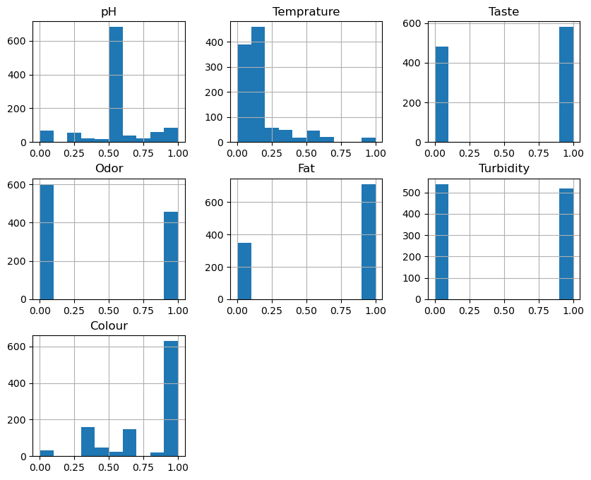
After Normalization
18

Slide 19
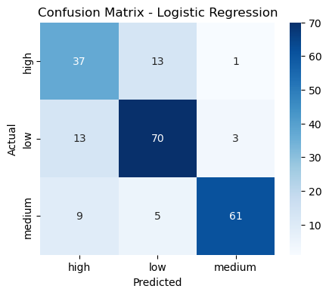
Data Accuracy Before Tuning
Test Accuracy:
Logistic Regression: 0.7925
Decision Trees: 0.9953
Random Forests: 0.9953
19

Slide 20
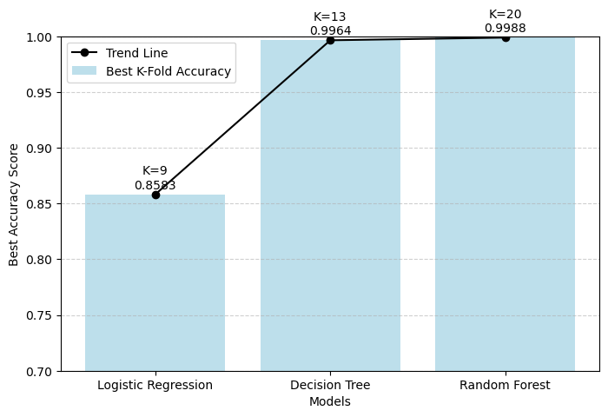
Data Accuracy After Tuning
20

Slide 21
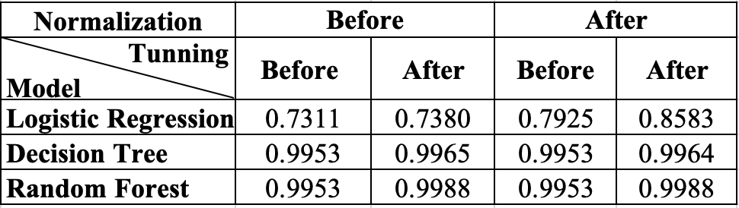
Both Tuning & Normalization Work
Logistic Regression benefits the most from both normalization and tuning, with accuracy increasing from 0.7311 → 0.8583 (a 17.4% improvement overall).
Decision Tree shows minimal improvement, increasing from 0.9953 → 0.9964 (only a 0.11% improvement overall).
Random Forest has a small but noticeable gain, improving from 0.9953 → 0.9988 (a 0.35% improvement overall).
Normalization significantly improves Logistic Regression performance
Tuning with K-Fold CV generally enhances model performance, with the biggest impact observed in Logistic Regression.
21

Slide 22
Conclusion
Based on the analysis, Logistic Regression is simple and interpretable but lacks sufficient accuracy (0.8583). Decision Tree is better at handling non-linear relationships with decent accuracy (0.9964) but is slightly easy to overfit. Lastly, Random Forest reaches the highest accuracy (0.9988) among the three models, is robust to overfitting, and handles complex data effectively.
Therefore, if interpretability is a key factor, Logistic Regression might still be preferred. If accuracy and robustness are the priority, then Random Forest is indeed the best choice. Random Forest is the most suitable model for the project.
22

Slide 23

Challenges
KNN Tuning Issue
After tuning, KNN’s accuracy dropped, and the optimal K was 1. Therefore, move to Logistic regression from the KNN model.
Tunning and CV order
Should we use cross-validation (CV) to find the best K first, then tune other hyperparameters, or vice versa
Small dataset cause high accuracy
Since the dataset is small, it is hard to see improvement for DT and RF models by following these steps. (Potential overfitting)
23

Slide 24
Thank you
24

